Slide 1
Aa
Short A
cat

Slide 2
Ee
Short E
leg

Slide 3
Ii
Short I
Sit

Slide 4
Oo
Short O
top

Slide 5
Uu
Short U
rub

Slide 6
oo u
Short O/U
book put

Slide 7
ai ay ey eigh
Long A
Paid Tray
They Neigh

Slide 8
ee ea
Long E
Bee
beat

Slide 9
ie igh y
Long I
pie high my

Slide 10
oe ow
Long O
toe bow

Slide 11
oo ue
Long Vowel
Moon Cue

Slide 12
ar
Controlled R
car

Slide 13
or
Controlled R
cork

Slide 14
er ir ur
Controlled R
Her Bird Hurt

Slide 15
ow ou
Other Vowels
Cow Out

Slide 16
oy oi
Other Vowels
Boy Coin

Slide 17
eer ear
Other Vowels
Deer Hear

Slide 18
air ere
Other Vowels
Hair There

Slide 19
our
Other Vowels
Tour

Slide 20
Pp
pin

Slide 21
Bb
bin

Slide 22
Tt
tip

Slide 23
Dd
dip

Slide 24
Kk Cc ck
King
Cold
back

Slide 25
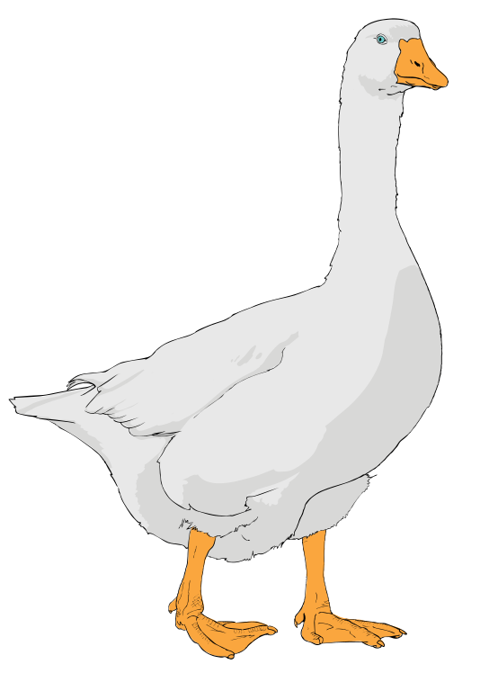
Gg
gold

Slide 26
Mm
mum

Slide 27
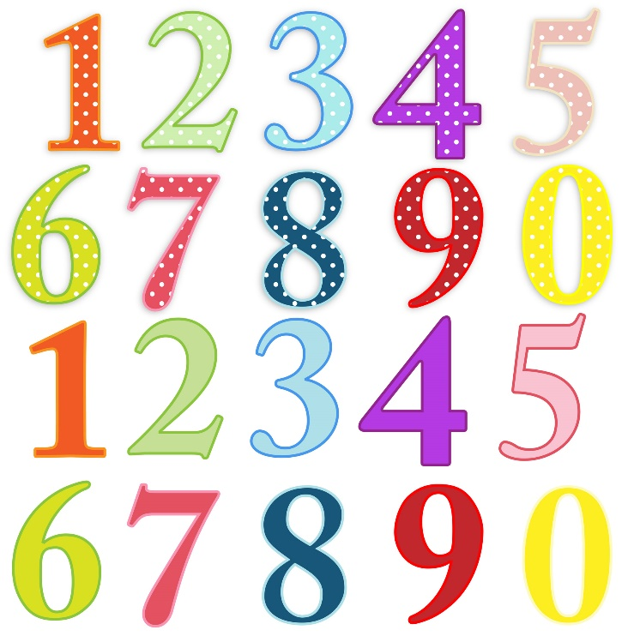
Nn
name

Slide 28
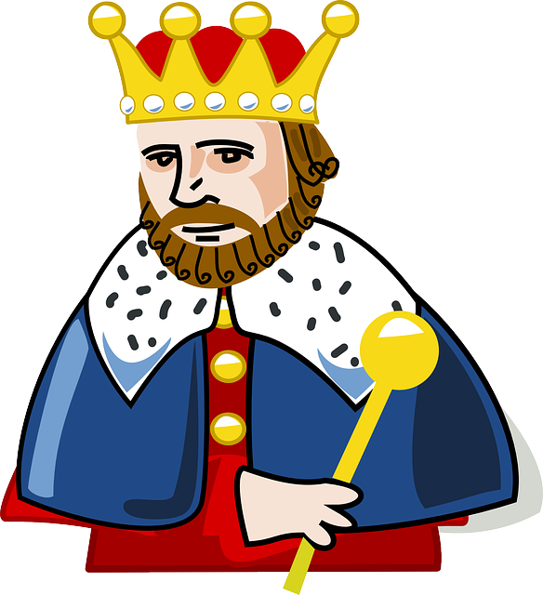
ng
sing

Slide 29
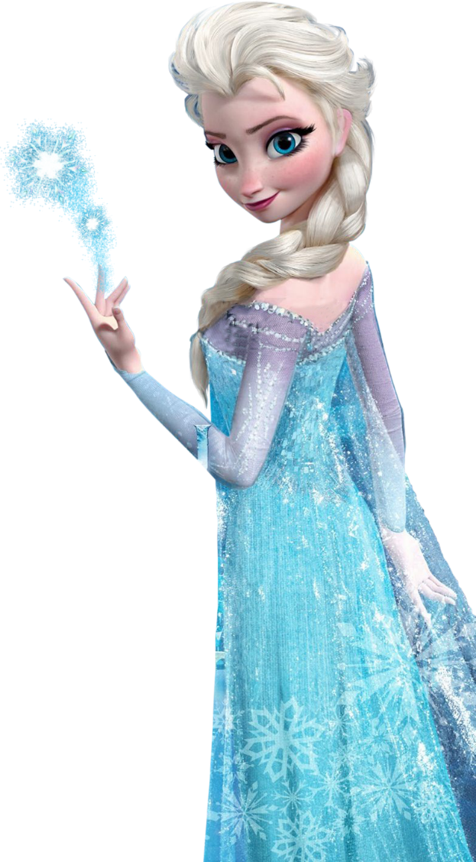
Ff
friend

Slide 30
Vv
vest

Slide 31
Th
Thin

Slide 32
Th
This

Slide 33
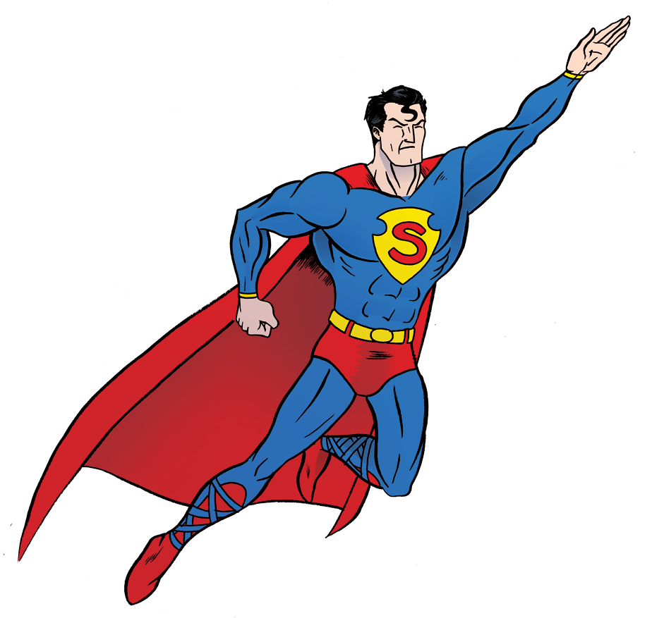
Ss
Silly

Slide 34
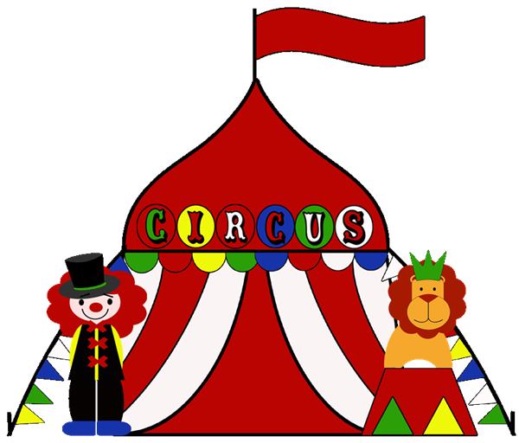
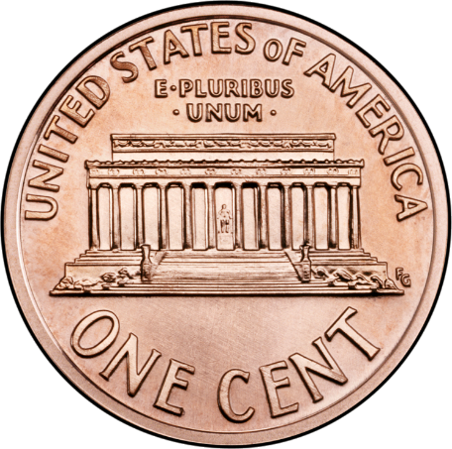
Cc
Second sound
cent

Slide 35
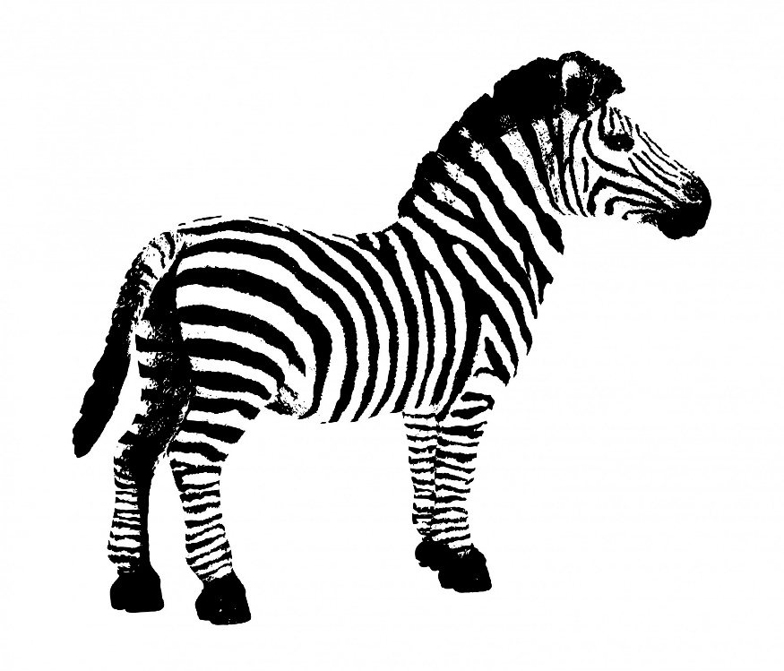
Zz
zip

Slide 36
Sh
Ship

Slide 37
ge “zh”
beige

Slide 38
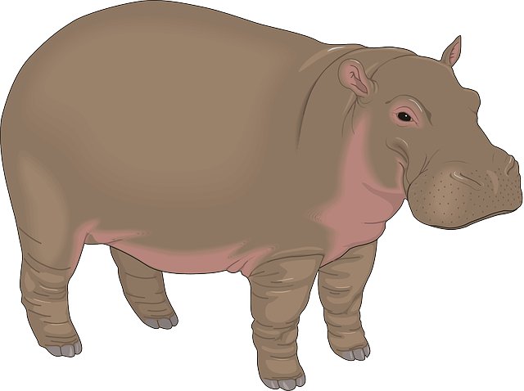
Hh
Head

Slide 39
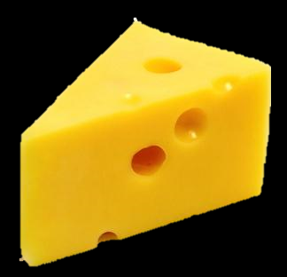
Ch
Chip

Slide 40
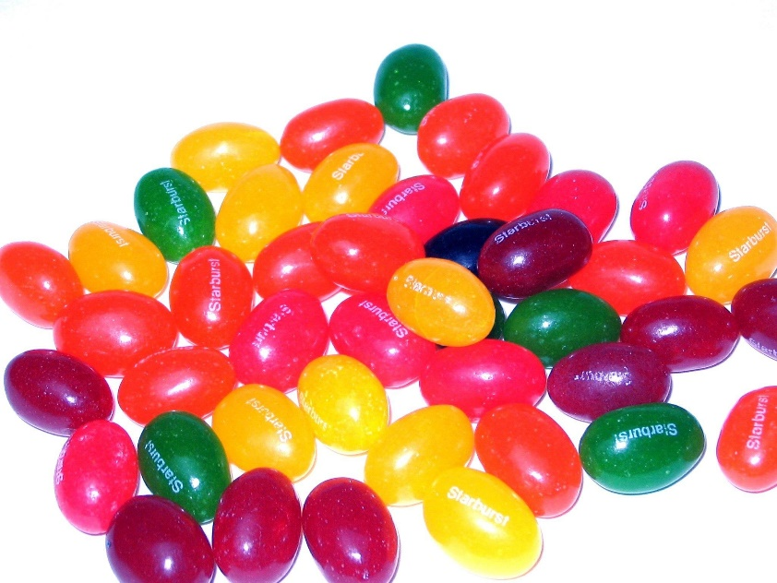
Jj
Jump

Slide 41
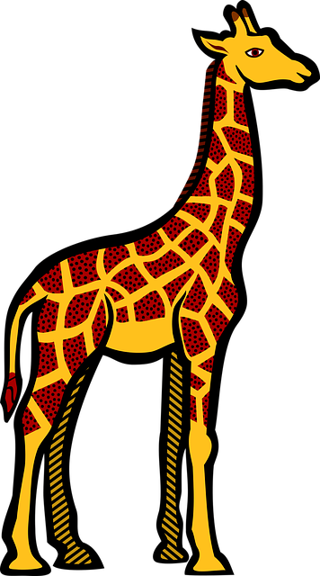
Gg
Second Sound
giant

Slide 42
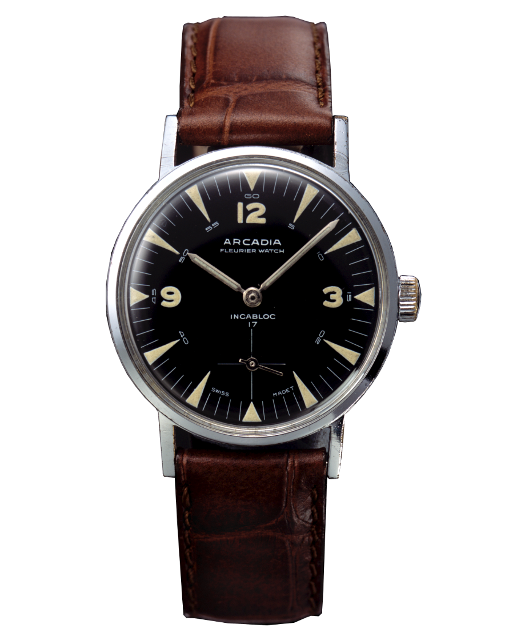
Ww Wh
Water
Whale

Slide 43
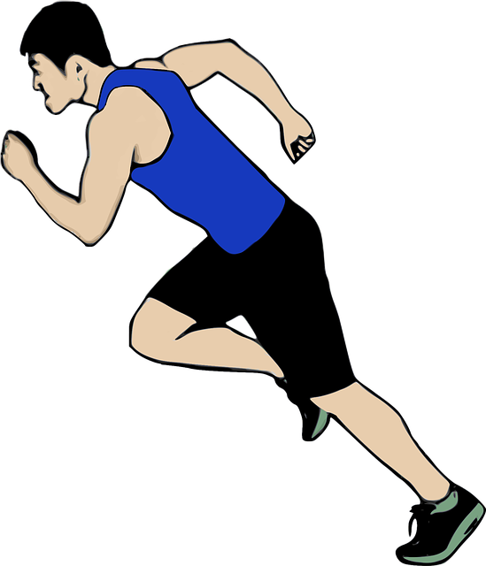
Rr Wr
Run Write

Slide 44
Yy
yellow

Slide 45
Ll
lips

Slide 46
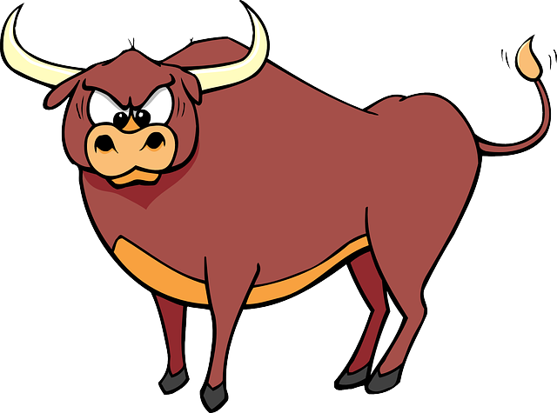
Xx
K + S = X
box

Slide 47
Qq
K + W = Q
queen

